Slide 1
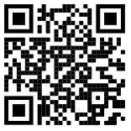


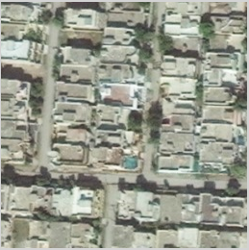
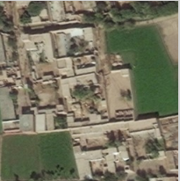
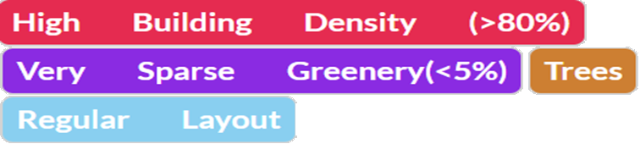
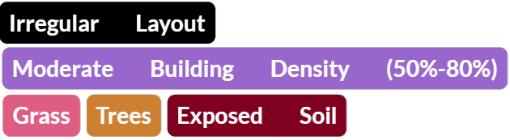
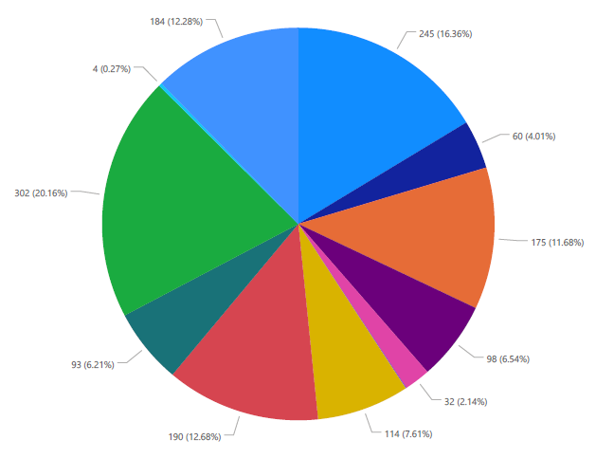
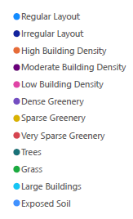
Detecting Planned and Unplanned Locality Using Satellite Imagery Ahmed Saleem . Haseeb Ali . Usman Tariq . Farrukh Butt Deep Learning 2020 Course Project
Problem Statement
Experiments Conducted
Results
Land usage patterns are very important for urban planning. The land development applications require the knowledge of already built structures and their status.
Field surveys are costly and time consuming due to extensiveness of the unplanned areas. So with the availability of satellite imagery, we can classify land up to much accuracy
We worked upon generating masks for satellite images to identify the buildup area. For that purpose, we used U-net and achieved an accuracy of 95% on training data. We worked around image preprocessing to achieve better results also overcome some difficulties related to loading tiff image format.
Current Results of Multi Label classification Model
 | Loss | Accuracy
High Building Density | 0.2849 | 0.4908
Moderate Building Density | 0.5028 | 0.8849
Low Building Density | 0.4356 | 0.7762
Regular Layout | 0.5788 | 0.8725
Irregular Layout | 0.5835 | 0.7300
Dense Greenery | 0.3670 | 0.7200
Sparse Greenery | 0.5877 | 0.9162
Very Sparse Greenery | 0.3845 | 0.7024
Grass | 0.3845 | 0.8562
Trees | 0.5712 | 0.7425
Large Buildings | 0.4000 | 0.8525
Exposed Soil | 0.5388 | 0.7887
Average | 5.7262 | 0.8187
Multi Label classification is used for classification. We get the best results at 10 conv. layers and 5 pooling layers.
Data Set
Pie chart showing the locality of Model Town Lahore with 12 labels
BING satellite with zoom level 19 is used to download the satellite imagery
Lahore, Peshawar and Hyderabad cities images are used in this project
More than 6000 images with resolution 256*256 are selected from the collected dataset
Dataturk (an online software) is used for image labelling

